Slide 1

The history of fighting games
Davierre Hackman

Slide 2

What Is A Fighting Game?
Fighting games, at their most basic level, are competitive matches between a player’s character and another character, controlled by either another player or the computer.

Slide 3
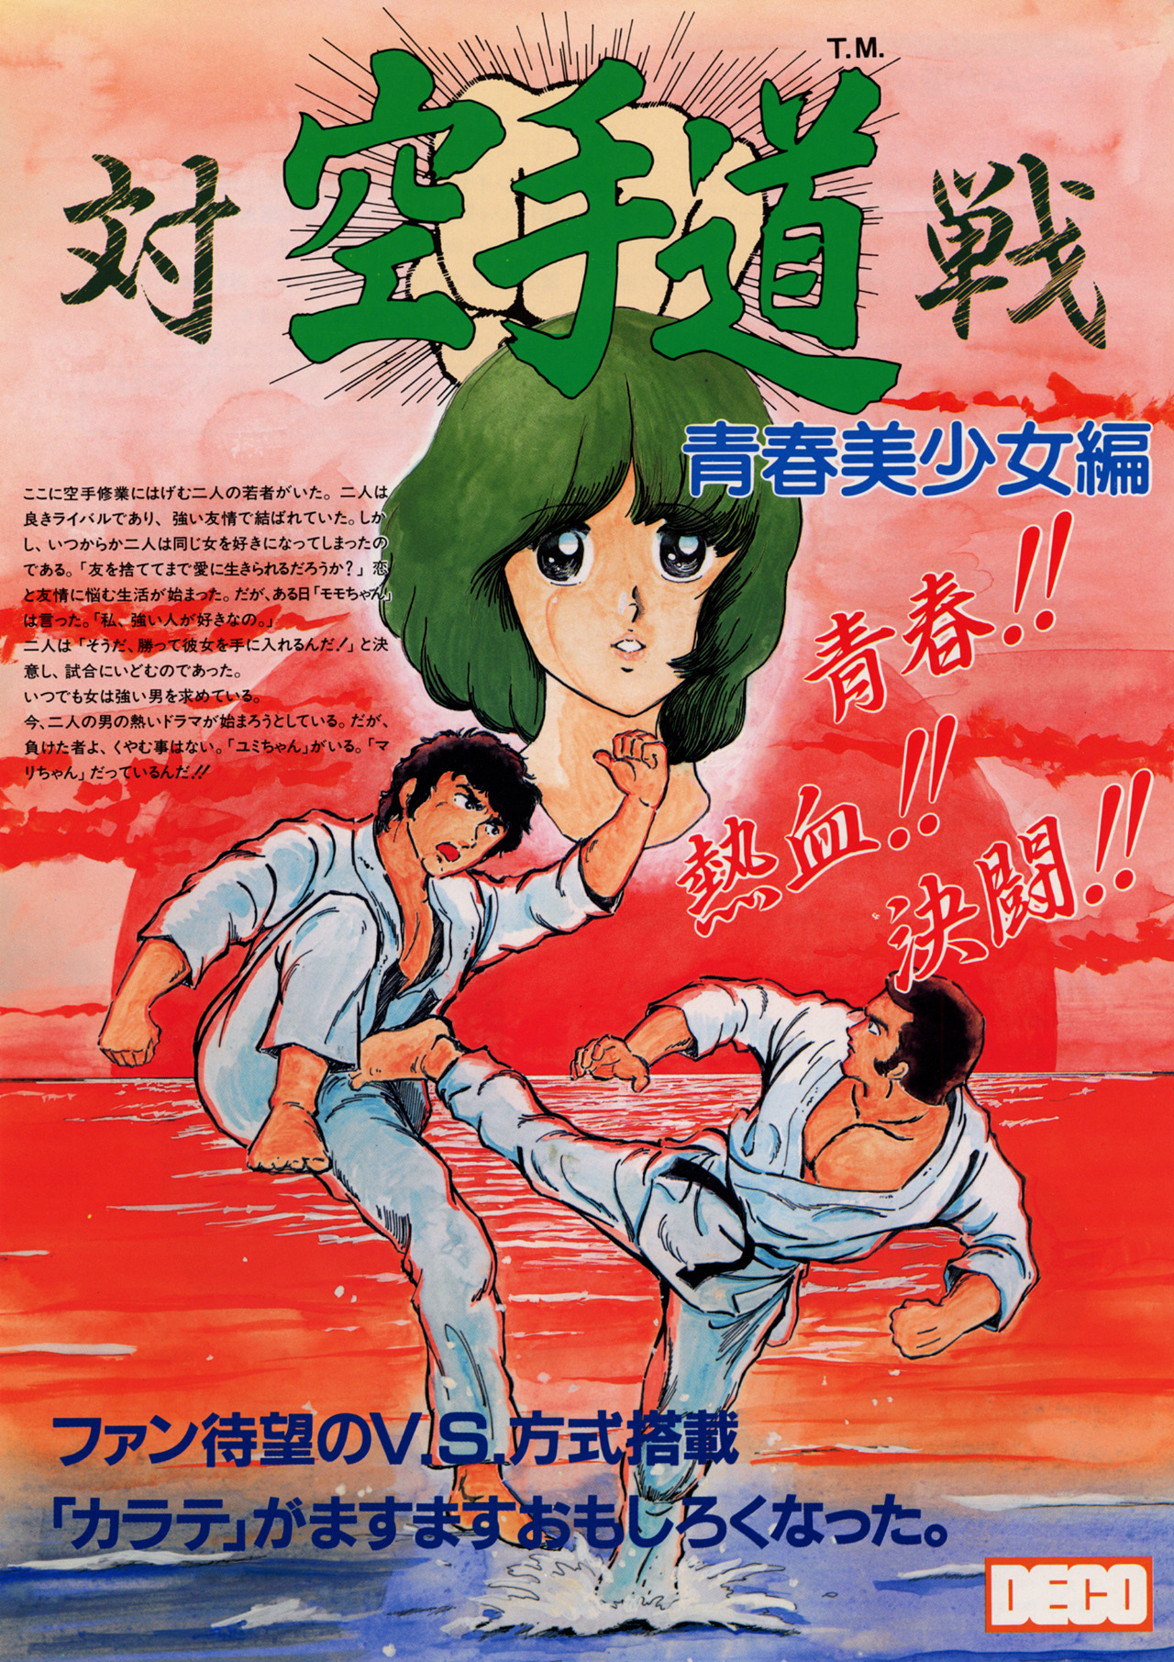
How Did They Start?
Fighting Games truly began back in the 80s with Bruce Lee.
His “Enter The Dragon” influenced a lot of developers to begin making their own games, trying to emulate the combat shown in the film.
The progenitor of 2D Fighters as we know it was created from this inspiration, Karate Champ!

Slide 4
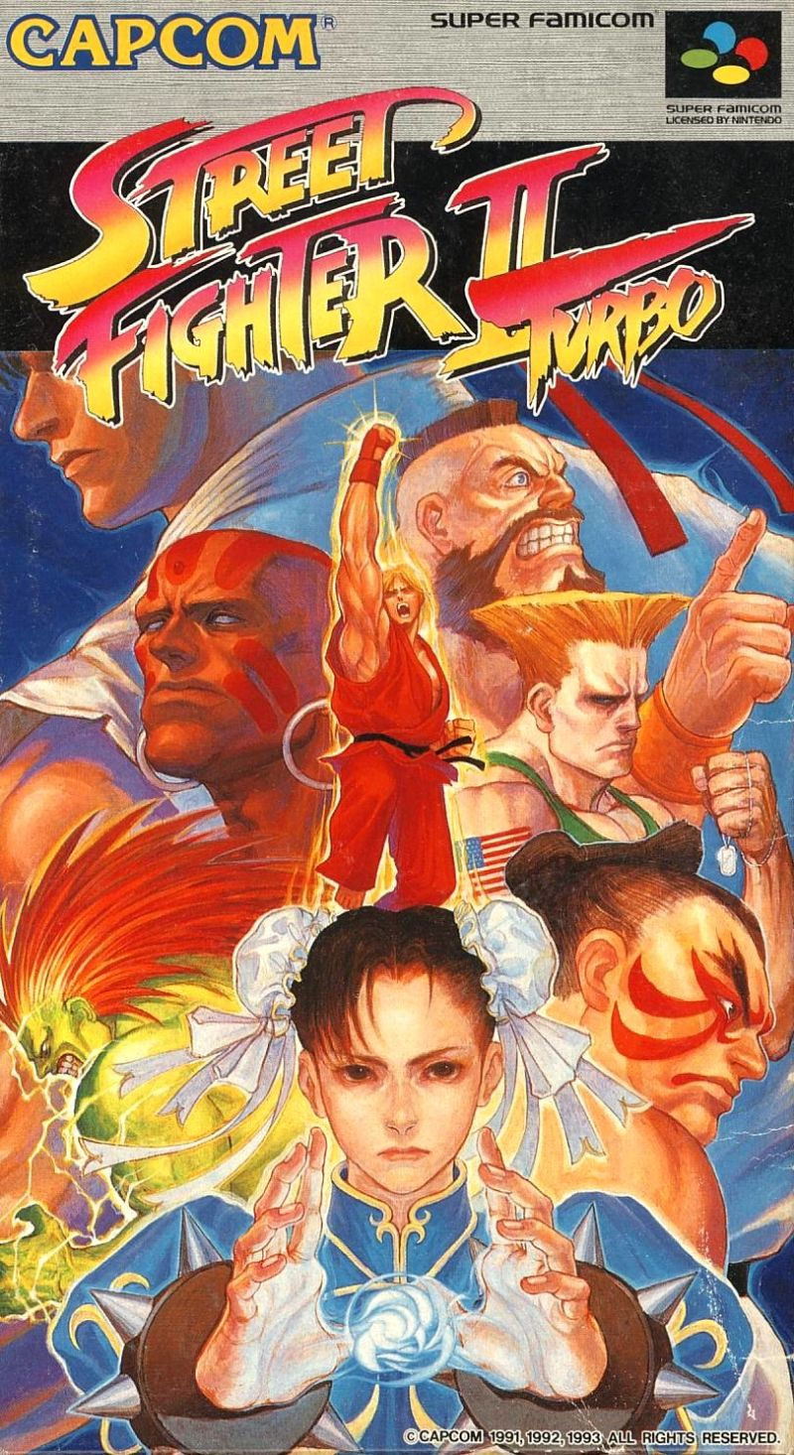
The Blow Up
Fighting Games were a relatively new genre at the time. No one knew how to create a proper one. It wasn’t until the release of the godfather of most, if not all fighting games, Street Fighter II, which sold over 25 million copies, that fighting games cemented themselves as a genre.

Slide 5
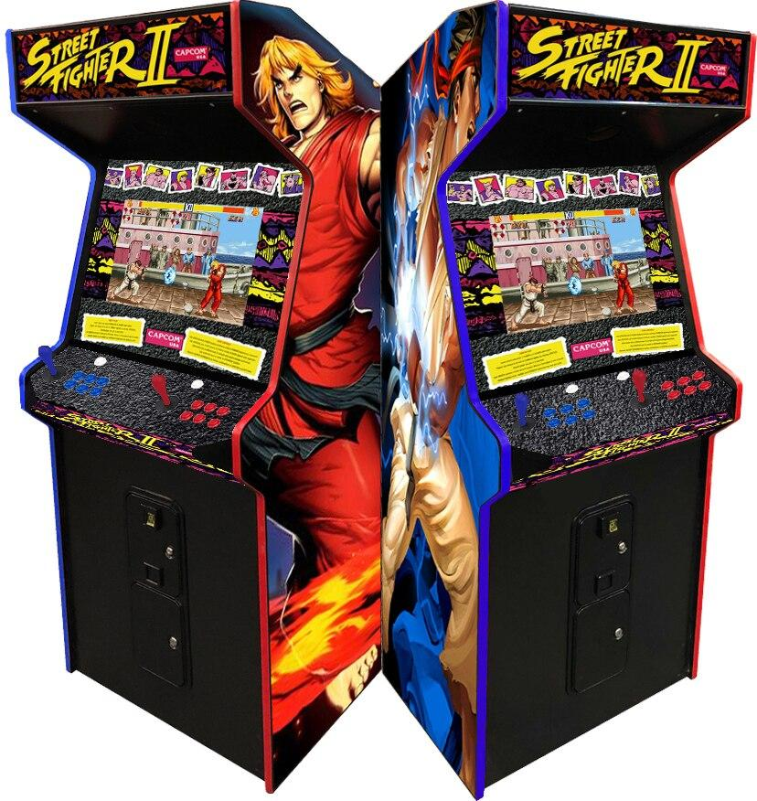
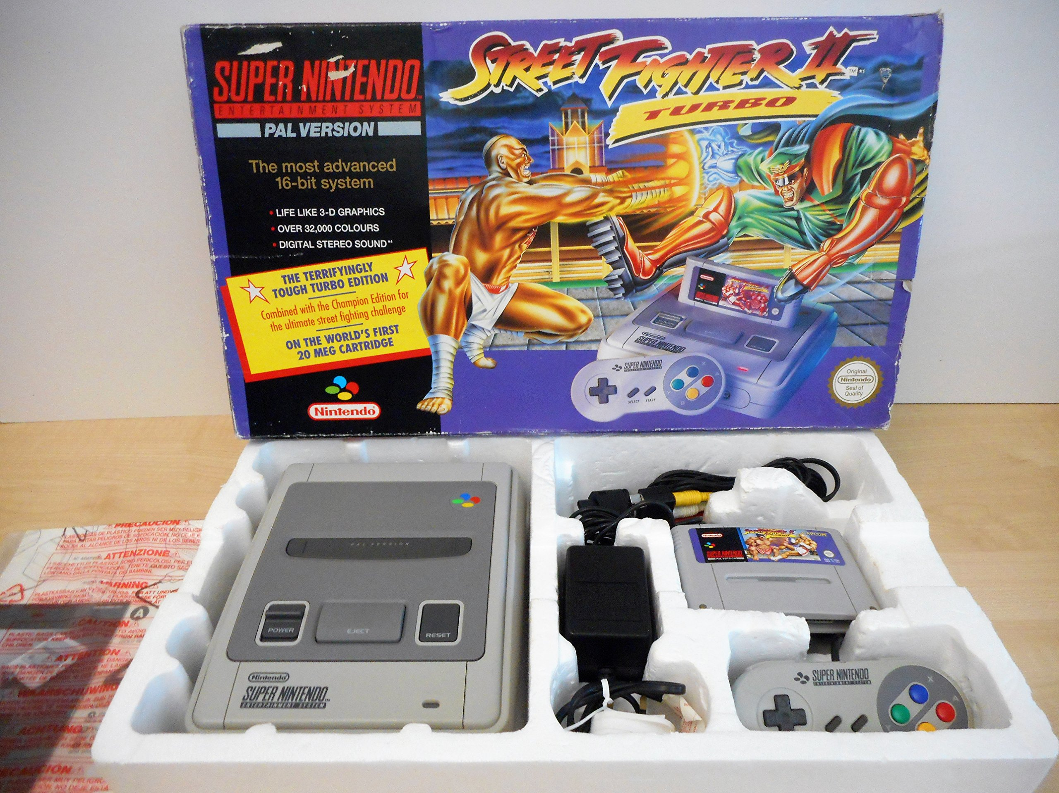

Slide 6
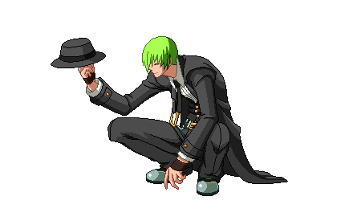
Fighting Games Vs. Congress
Despite the success they received, as fighting games evolved and more fighting game companies branched off creating their own titles, they met their fair share of push back, especially with the introduction of the Mortal Kombat series.

Slide 7
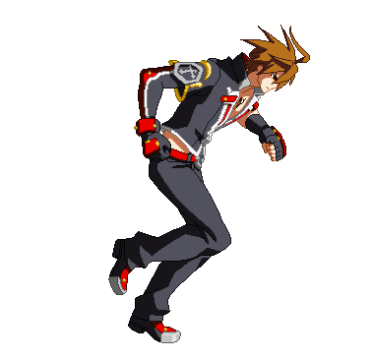
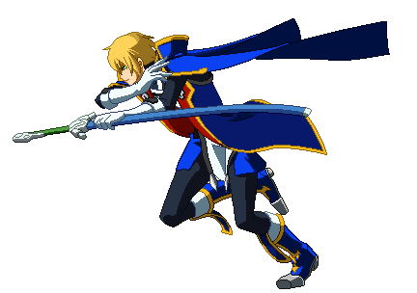
The Evolution
As technology continued to evolve, so did fighting games, leading to subgenres (new takes on the fighting game genre) being formed.
Some of these subgenres included, 3D Fighters, Air Dash Fighters, Arena Fighters, Tag Fighters, and Platform Fighters.

Slide 8
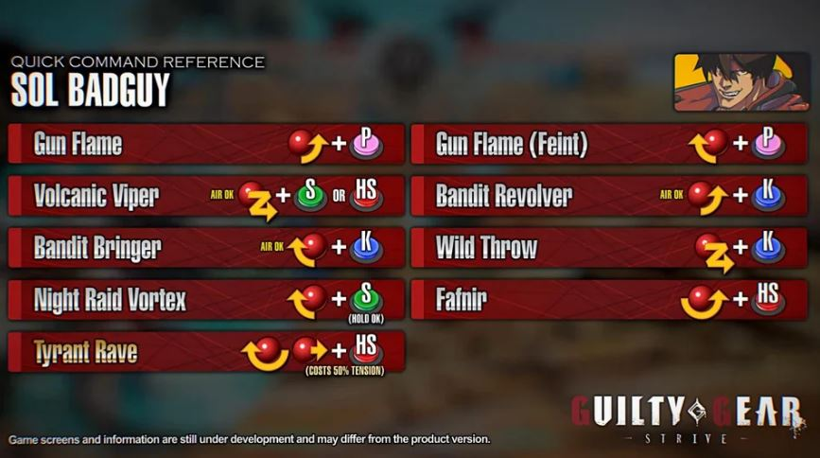
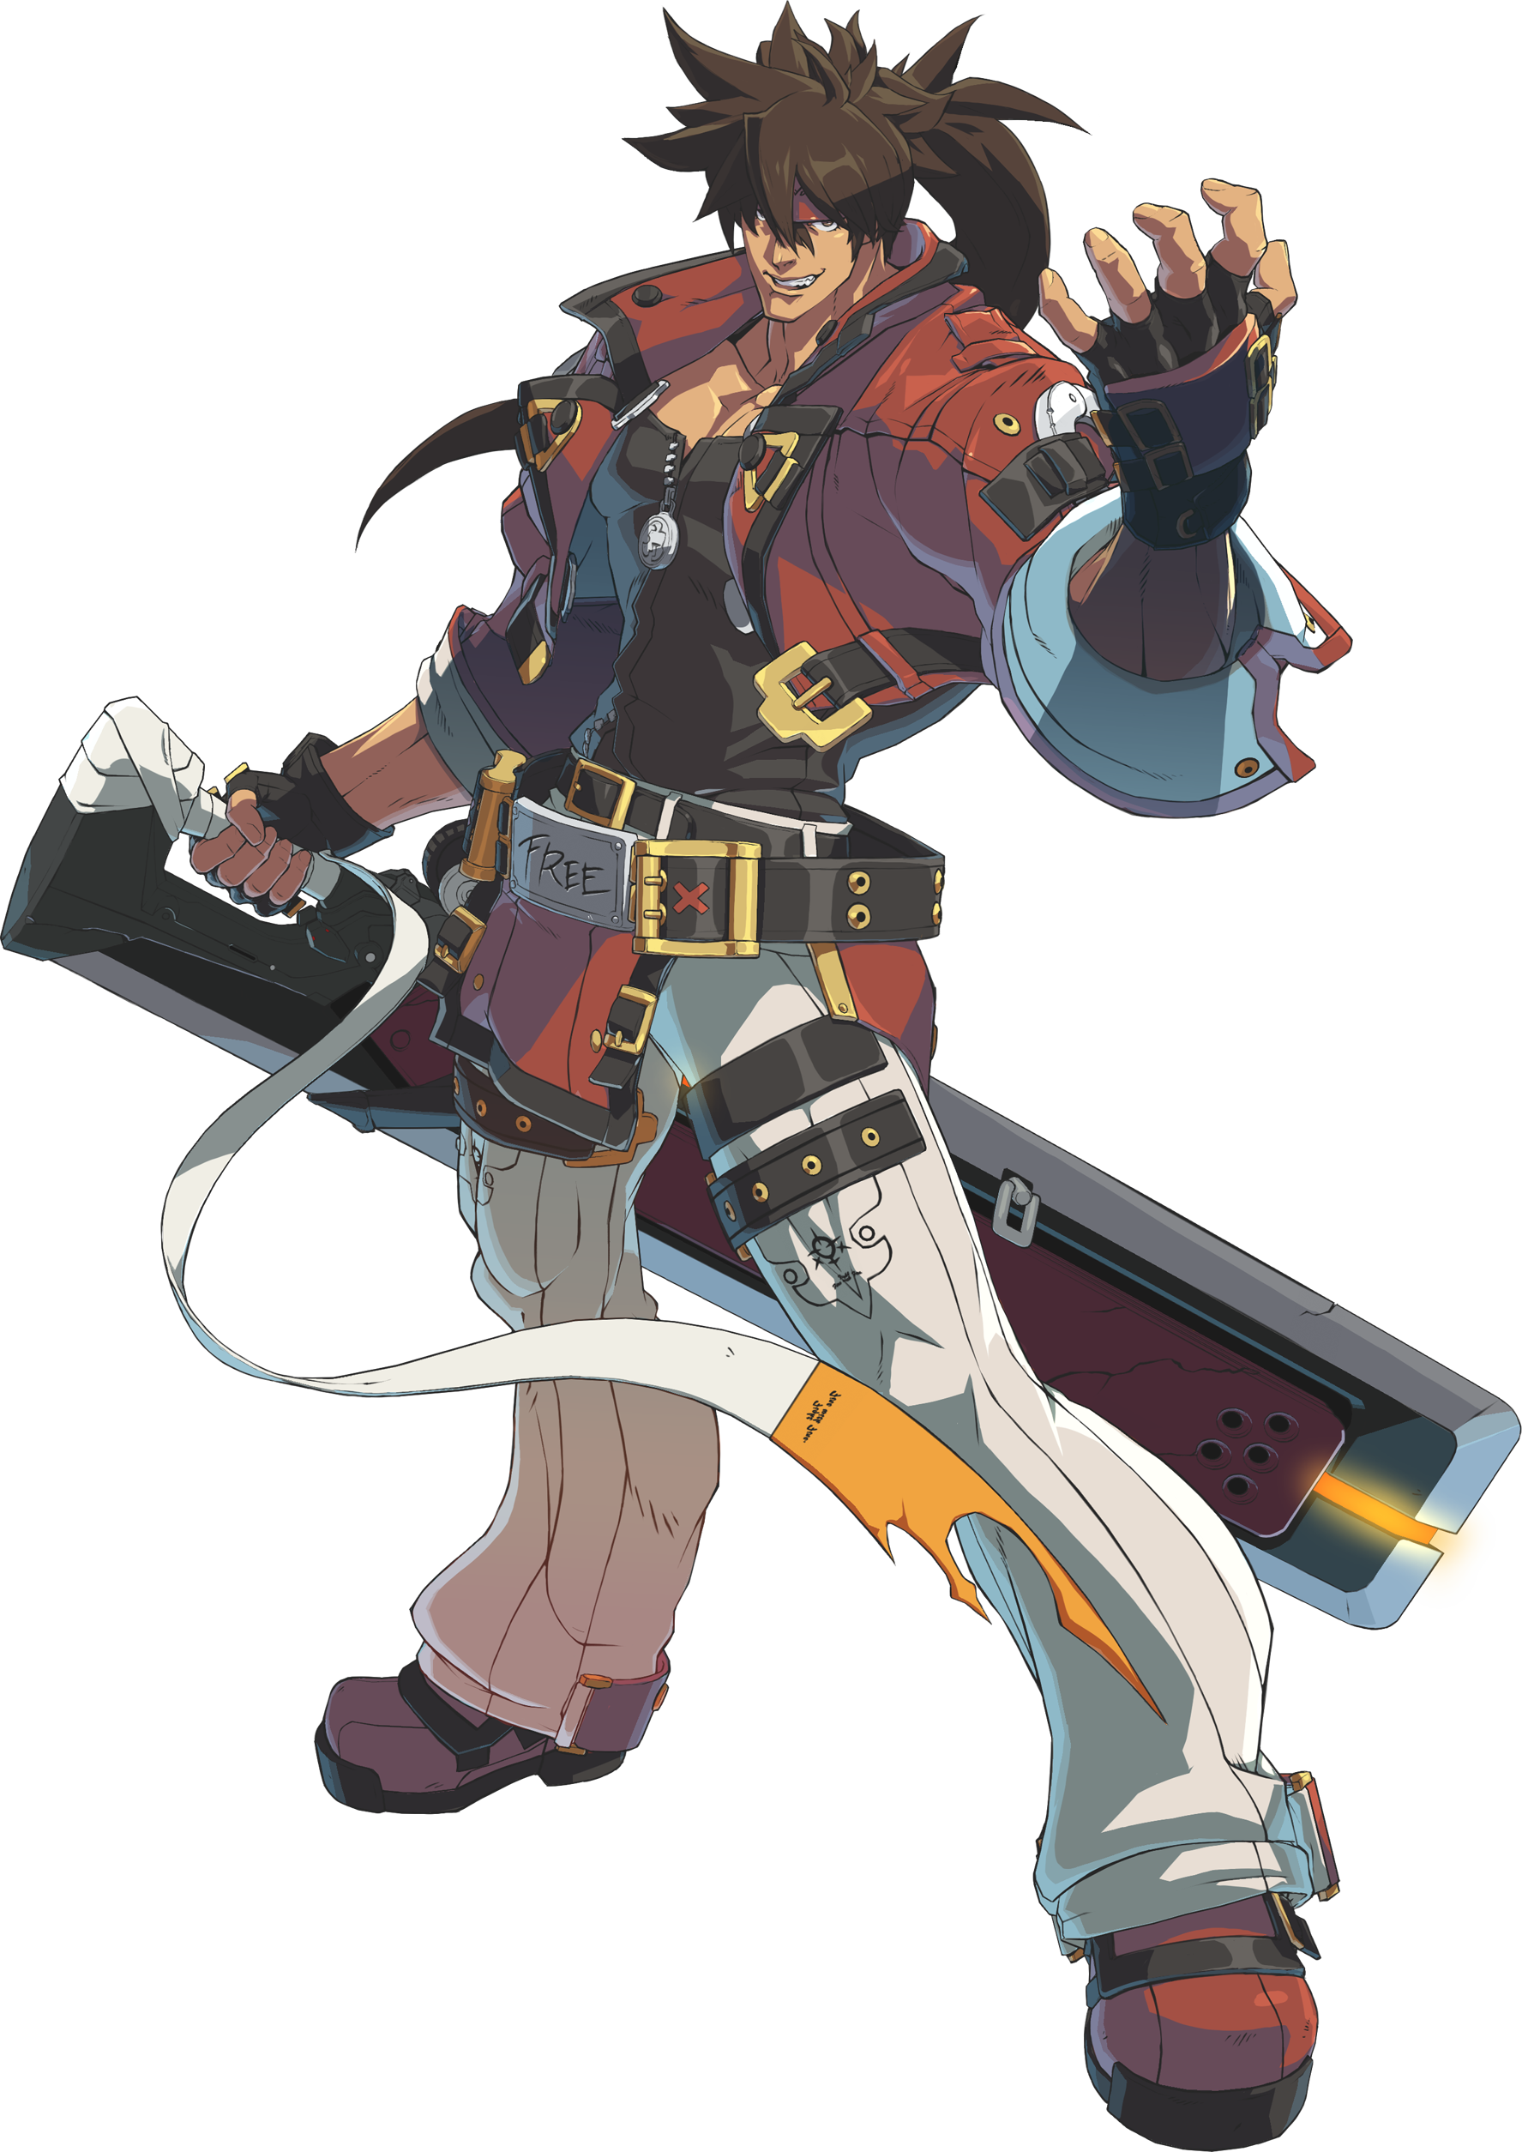
Skill: A Positive or a Negative?
As fighting games continued to evolve, they began to run into yet another problem, though this problem comes with evolution. They were becoming incredibly complicated, harder to learn, and especially harder to master.

Slide 9
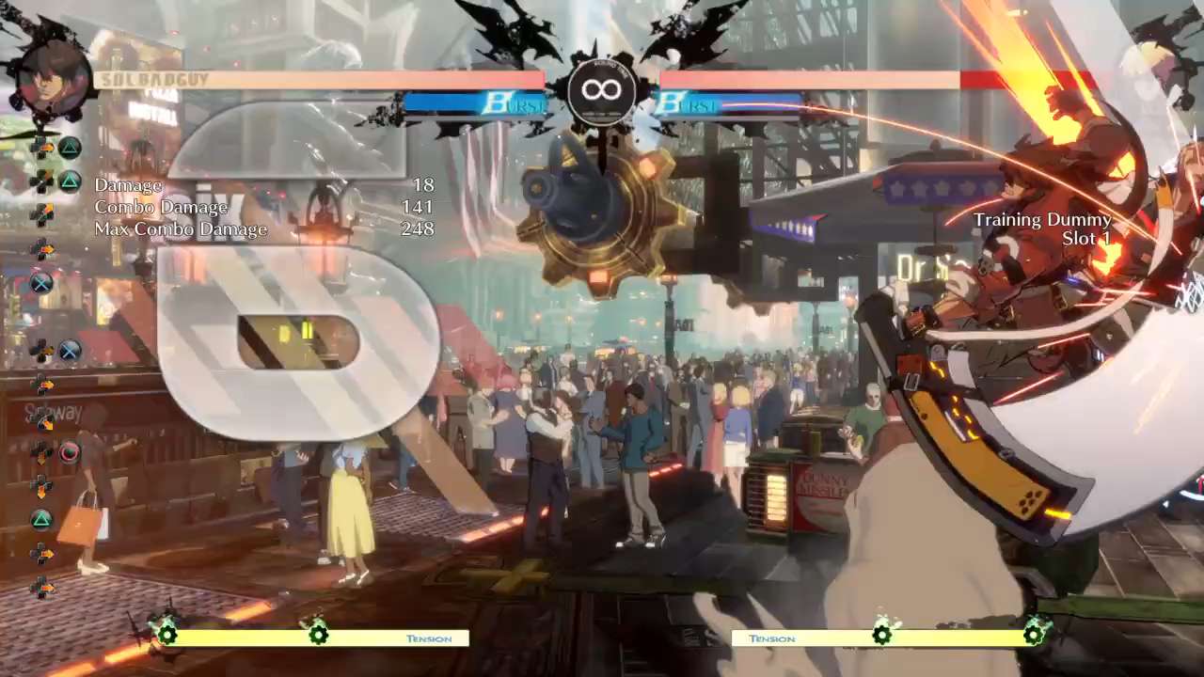

Slide 10
The Future of Fighting Games
Fighting games, though not the biggest genre, continues to have a very active and supportive community.
You can even find official work by being a strong fighting game player. You can join pro teams and fight for that team, making an annual salary.
A plethora of fighting game players have been able to create careers out of playing competitively, cementing their names in history.

Slide 11
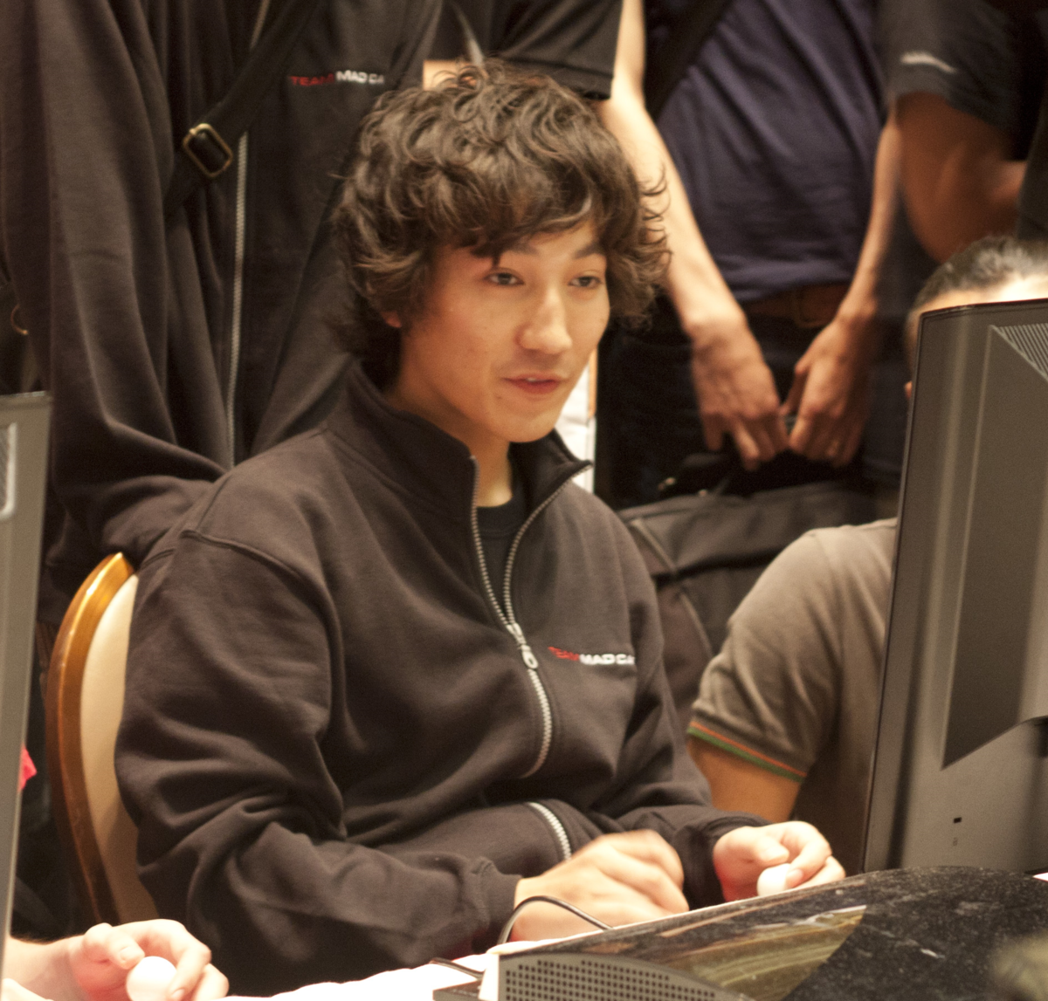
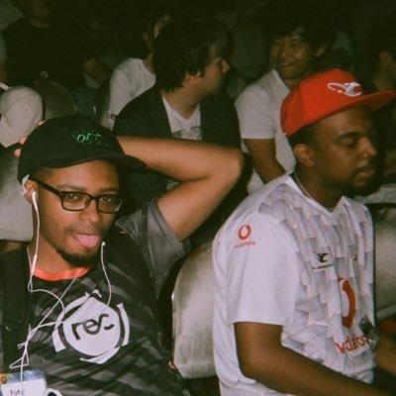
DAIGO (The Beast)
Punk Da God & Problem X

